Slide 1
It’s not just an app, It’s a Lifestyle

Slide 2
Group 1
Team Lead: Jonathan Sullivan
Design Lead: Bob Allan
Test Lead: Sam Bauter

Slide 3
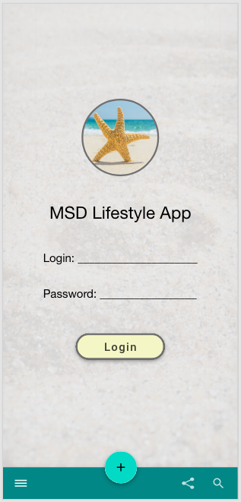

Design
For our mock-up I used Adobe XD
There are many resources available to help create realistic Android designs

Slide 4
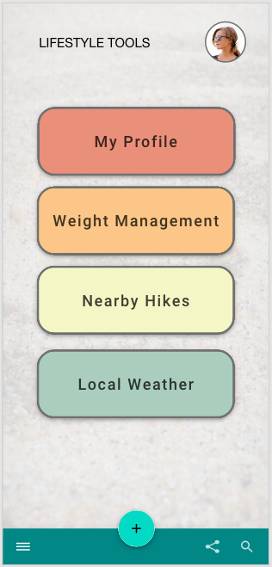
Design
We want our app to be clean, colorful, and easy to use.

Slide 5
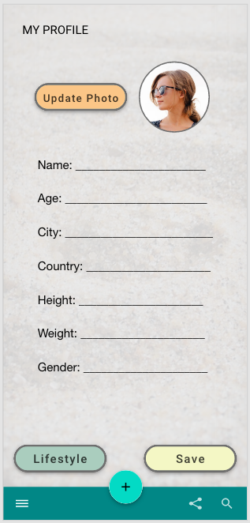
Design
Vertical-only orientation
There are many popular fitness apps, like Strava and MyFitnessPal that are vertical-only

Slide 6
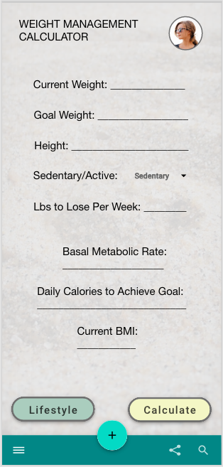
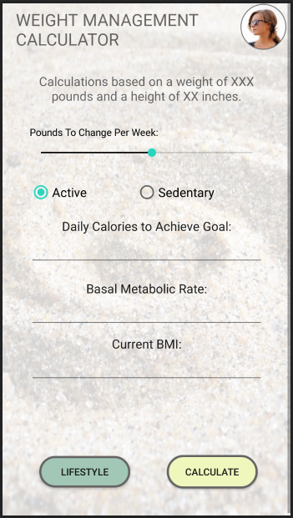
Design
BMI button is unnecessary, the calculation can be done in with the profile data.
Our design has evolved to meet client requests by adding sliders and removing text fields.

Slide 7
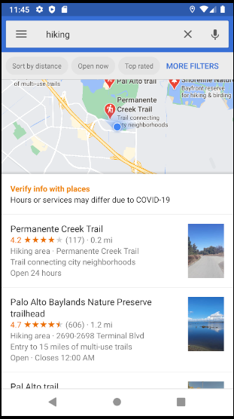
Design
Google Maps API is as easy as pie

Slide 8

Design
Weather API is not as easy as pie, but it will look nice once we sort it out

Slide 9
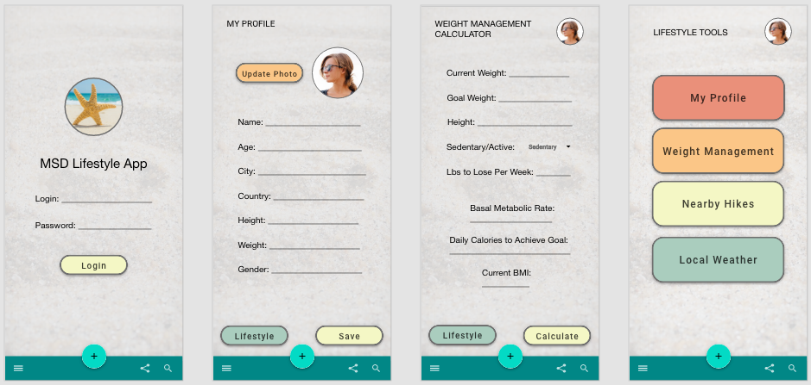
Design

Slide 10
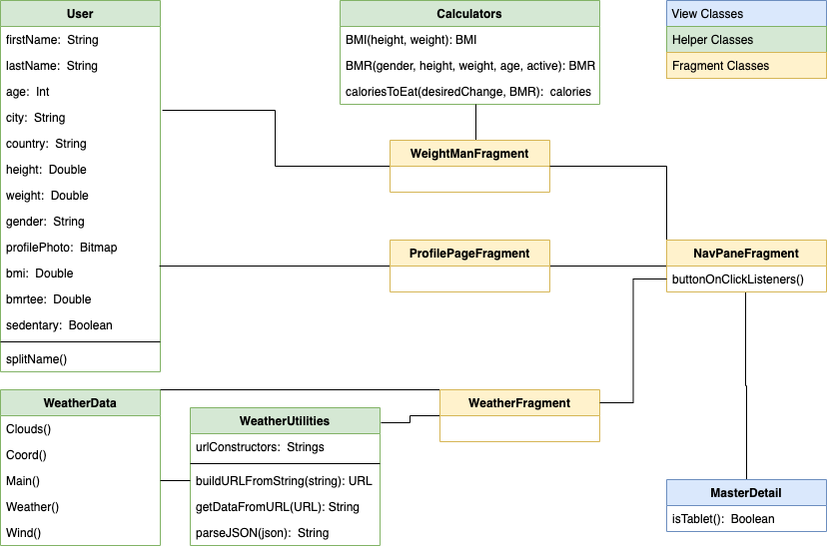
Class diagram

Slide 11
Class choices
User data class
Allows for additional future users
Kotlin automatically generates getters/setters
Weight-related calculator helper class
Static functions that can be called from anywhere
Weather data class
Easier to parse JSON with Gson
Supported by weather helper class functions

Slide 12
Bugs and their fixes
Activities were not scrollable on smaller screens
Include ScrollView tags
Profile male/female radio buttons not radioing
Do not put a LinearLayout inside of a RadioGroup, instead use the orientation attribute of RadioGroup
Camera crashing when attempting to launch from profile activity
Does not actually seem to be app-related. Possible issues with emulators / API versions.
Input field text does not go away when field selected
Use “hints” rather than “text”
Managing GitHub for multiple users is complicated
Branches are your friend

Slide 13
Tests and testing
Two Main types of test in Android Development:
Normal JVM Testing
Tests simple functionality of Java helper classes and other non-Android API tests.
Faster Runtimes! Only requires the JVM to run testing rather than emulating a full android environment.
Instrumented Tests
Versatile testing strategy that allows you to test Android features and capabilities
Can test user interactions with the device.
Ex: ViewMatcher methods: withId, withText, isDisplayed, isChecked etc
Ex: ViewAction methods: click, typeText etc

Slide 14
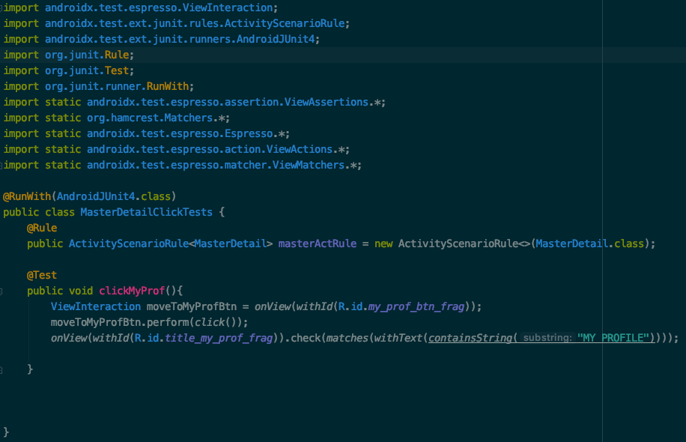
A Simple Instrumented Test

